Slide 1
Alleviate the Agony of Assessments

Slide 2
Overview
Assessments in general
Tests
Rubrics
Supporting state exams
Notes:
Good assessment isn’t just one type. The assessment puzzle takes a variety of pieces to meet different needs, teaching strategies, and learning goals.

Slide 3
  Assessments have an impact on the overall quality of students’ learning and instructors’ teaching.
  Assessment is perhaps the most neglected feature of good instruction.
  An assessment is not only a grading device, but also a teaching technique.

Slide 4
Many teachers report that they do not like to write tests, score tests, or report test results to their students.
They hate to be hassled by students who think a test item was ambiguous or claim that the instructor misinterpreted what was written.

Slide 5
Wish list:
  I want my students to love to learn.
Reality check:
  Students’ first question is often, “What’s going to be on the test?”
Notes:
If you want to promote critical thinking, write test items that emphasize understanding, application, and other higher-level skills.
Research and anecdotal evidence indicate that students learn according to how they are tested.

Slide 6
If you want to promote critical thinking, write test items that emphasize understanding, application, and other higher-level skills.
Research and anecdotal evidence indicate that students learn according to how they are tested.

Slide 7
Students will study for the type of test they expect.
  If they expect a vocabulary test, that’s what they will study.
  If they expect a test that requires them to apply what they have learned, they will do a different type of studying.

Slide 8
Common goal of exemplary assessments/assignments
Address all cognitive levels
Include both rigor and relevance

Slide 9
Simplify Blooms into 3 categories
Level 1 is necessary. It’s also the easiest level to write assessments for.
Students can’t get through medical school without memorizing, but we all hope our doctors will be able to apply the facts they learn.
It’s the content for the context of the assessment!

Slide 10
Level 2 moved students into understanding and applying their knowledge to new circumstances.
Level 3 gets tougher to assess using a paper and pencil test. (This is where rubrics really shine as an assessment tool!)

Slide 11
Bloom’s Taxonomy
Creating
Evaluating
Analyzing
Applying
Understanding
Remembering
Level 3
Level 2
Level 1
Notes:
Starting with Bloom’s Taxonomy, and realizing we were going to be using volunteers and busy classroom teachers, we simplified Blooms into three categories.
Level 1 is necessary. It’s also the easiest level to write assessments for. However, we wanted our assessments to move higher. Students can’t get through medical school without memorizing, but we all hope our doctors will be able to apply the facts they learn.
Level 2 moved students into understanding and applying their knowledge to new circumstances.
Level 3 gets tougher to assess using a paper and pencil test. Each test had level 3 questions, but this is where rubrics really shine as an assessment tool.

Slide 12
List of Action Words Related to Critical Thinking Skills
Remember | Understand | Apply | Analyze | Evaluate | Create
Choose Cite Count Define Describe Draw Identify Label List Listen Match Memorize Name Outline Point Quote Read Recall Recite Recognize Record Repeat Reproduce Review Select Show State Underline Write | Annotate Ask Associate Compute Convert Defend Describe Discuss Distinguish Estimate Expand on Explain Express Extend Extrapolate Generalize Give examples Give main idea Infer Locate Outline Paraphrase Predict Research Restate Rewrite Summarize Translate | Adapt Add Apply Calculate Change Classify Complete Compute Construct Demonstrate Discover Divide Draw Examine Exhibit Experiment Graph Illustrate Interpolate Interpret Interview Make Manipulate Modify Operate Prepare Produce Schedule Show Solve Subtract Teach Translate Use | Analyze Appraise Arrange Breakdown Combine Compare Criticize Debate Design Detect Develop Diagram Differentiate Discriminate Dissect Experiment Illustrate Infer Inspect Investigate Organize Outline Point out Relate Research Select Separate Sequence Sift Subdivide Utilize | Appraise Assess Compare Conclude Contrast Criticize Critique Determine Grade Interpret Judge Justify Measure Rank Rate Support Test | Categorize Combine Compile Compose Create Drive Design Devise Explain Generate Group Integrate Modify Order Organize Plan Predict Prescribe Propose Rearrange Reconstruct Related Reorganize Revise Rewrite Specify Summarize Transform
Level 1 | Level 2 | Level 3
These terms are organized according to the different levels of higher-order thinking skills contained in Anderson and Krathwohl’s (2001) revised version of Bloom’s taxonomy. Adapted from http://www.k-state.edu/assessment/Learning/action.htm
Notes:
We provided our teaches with two tools to help identify what level their assessments addressed.

Slide 13
Understand
(Comprehension)
Apply
Question Level | Definition | Verbs
Remember (Knowledge) | Recall or recognition of specific information
Understand (Comprehension) Apply (Application) | Understanding of information given Using methods, concepts, principles, and theories in new situations
Analyze (Analysis) Evaluate (Synthesis) Create (Evaluation) | Break down information into its constituent elements Putting together constituent elements or parts to form a whole requiring original creative thinking. Judging the values of ideas, materials and methods by developing and applying standards and criteria
1
relate
record
recall
memorize
define
repeat
name
list
recognize
tell
locate
express
restate
discuss
review
explain
report
describe
schedule
practice
interpret
demonstrate
translate
use
apply
operate
illustrate
2
appraise
arrange
assemble
assess
calculate
compare
compose
construct
create
debate
design
differentiate
evaluate
examine
experiment
Inspect
judge
organize
plan
predict
prepare
propose
rate
relate
solve
value
3

Slide 14
Which Assessment Tool to Use

Slide 15
Assessments
Written Tests
Rubrics
Notes:
Each have their strengths.
Whether the test or the rubric is the best to use depends on the content and the cognitive skills to be measured

Slide 16
Tests
Content
to Be Covered
Appropriate for
most content.
Cognitive Skills
to Be Measured
Can measure all cognitive skills,
but primarily middle and lower levels.
Notes:
We’ll first talk about the written tests developed
A test plan typically has two components: the content to be covered and the cognitive skills to be measured on the test.

Slide 17
Written Tests
Tests can be a learning AND an assessment tool. In any one test, students should be able to demonstrate that they know the terminology, that they understand the concepts, that they can apply this to new situations, and that they can analyze and evaluate based on what they have learned.
They are the proof that the student understands the material or is able to apply the knowledge gained to real-world circumstances.

Slide 18
General Guidelines for Test Development

Slide 19
1. Cognitive Level
Goal should be no more than 40% of the questions at level 1.
Identifying level 1.
  If you give an open-book test, and the student can make a 100 without having read the chapter first.
  If the student can point to the answer.
Notes:
Level 1 is important. Some doctors say that the ability to memorize is an essential skill success in medical school.

Slide 20
Moving Up
One way a level one question can be converted to a higher level question is by providing a narrative.
The student must apply knowledge to a new situation.
Notes:
If teachers want to measure at higher levels like application or analysis, they must use novel situations in the questions. If they use the same example or situation that was used in class or in the text, then the question may be measuring only recall of that information and not application or analysis at all.

Slide 21
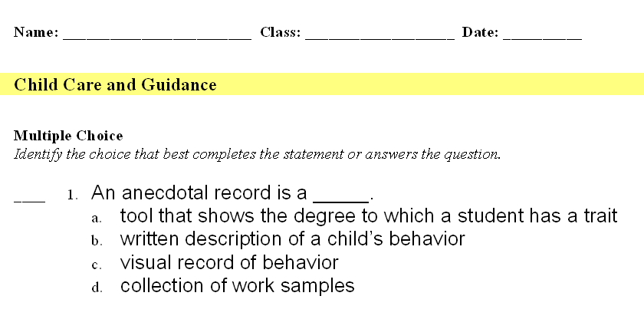
Level 1

Slide 22
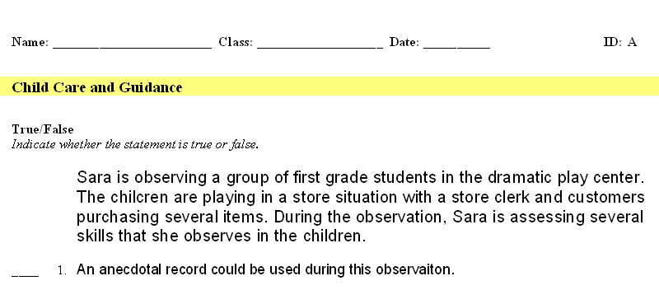
Move to Level 2 - Applying
Sara is observing a group of first grade students in the dramatic play center. The children are playing in a store situation with a store clerk and customers purchasing several items. During the observation, Sara is assessing several skills that she observes in the children.
____ 1. An anecdotal record could be used during this observation.

Slide 23
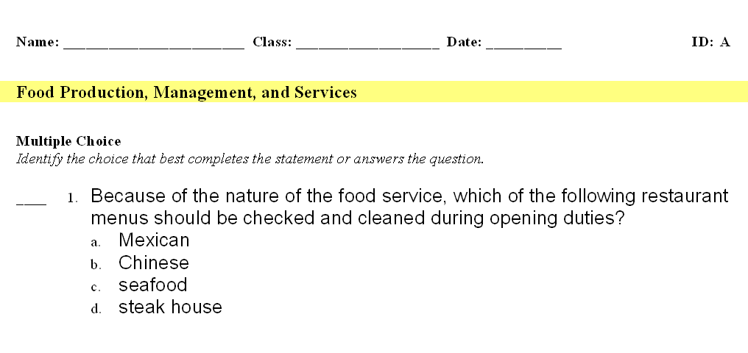
2. No Biases
Notes:
The teacher said the correct answer is “Mexican.”
Why would Mexican menus need to be checked and cleaned more than any of the others? Is she insinuating that people in Mexican restaurants are messier than people who eat in other restaurants? Is this being prejudiced? According to the test-writer, the chips and salsa were thought to be messier and had no reflection on the ethnicity; however, a Hispanic student might think otherwise.

Slide 24
3. Learning Goals
Make sure the main point of the question is the main point you want them to remember.

Slide 25
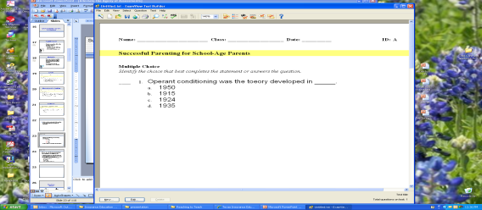
Multiple Choice
Identify the choice that best completed the statement or answers the question.
Operant conditioning was the theory developed in ___.
  1950
  1915
  1924
  1935
Is this really what you want the student to study and remember?

Slide 26
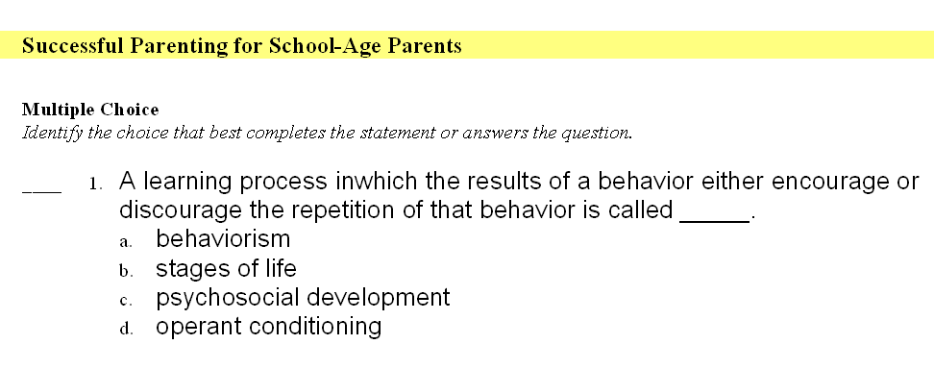
Or do we want them to remember what operant conditioning is?
____ 1. A learning process in which the results of a behavior either encourage or discourage the repetition of that behavior is called _____.
Notes:
Which reinforces the objectives of the lesson? The previous question or this one?

Slide 27
Multiple-Choice

Slide 28
Multiple-Choice
Many cognitive abilities can be tested.
Can measure wide range of content.

Slide 29
Multiple-Choice
Good
  Write the stem so students can formulate a tentative answer even before reading the options.
  Distracters should be plausible.
  Each choice should be about the same length.
  Use positive statements.
  Arrange answers in logical order: chronological, numerical, length (reminds you that the longest answer is often the right one).
  Arrange choices vertically.

Slide 30
Multiple-Choice
Not so good
  Don’t pad the stem with unnecessary words.
  Avoid determiners such as all, never, and always, which are usually found in incorrect options.
  Avoid determiners such as usually, sometimes, typically, and maybe which are more likely to be found in correct options.
  Rarely use “all of the above” or “none of the above.”
  If use negative statements, capitalize or bold the NOT or EXCEPT.

Slide 31
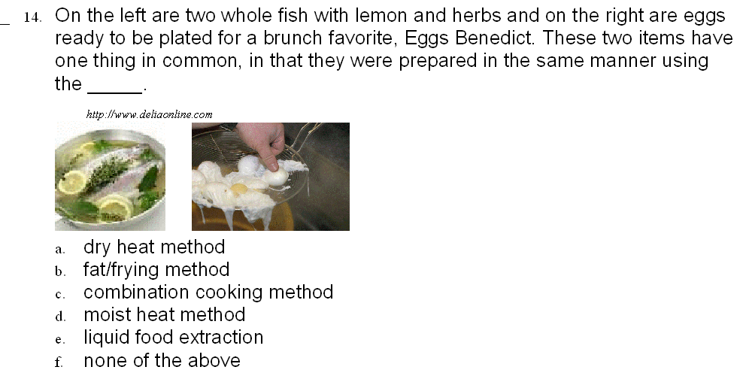
Multiple-Choice

Slide 32
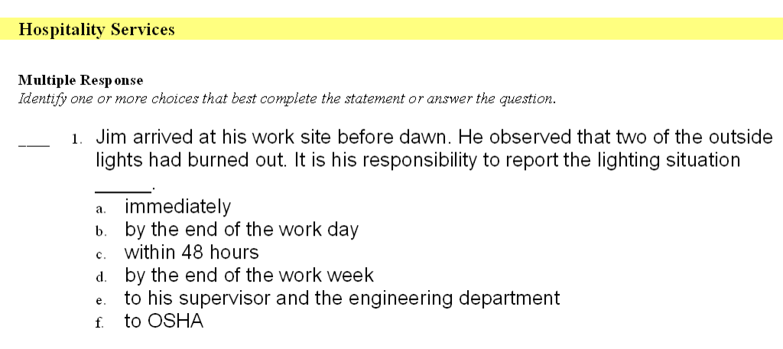
Multiple Response

Slide 34
Family and Consumer Sciences Across the Curriculum:
Helping Students with Common Core testing/standards
Writing math, science, social studies, and language arts questions over FCS content

Slide 35
Testing Outside FCS
Goals:
  To combine the Family and Consumer Sciences objectives with the language arts, math, science, and social studies common core standards.
  To assist student preparation for mandated testing.
  To demonstrate to students that what they learn in other classes will be a useful skill.
  To demonstrate to students that what they learn in their FCS classes builds on and applies the knowledge and skills acquired in other classes.

Slide 36
Testing Outside FCS
Write questions over FCS content but also address one or more of the tested objectives from the four core areas.
Questions are intended to be used as class warm-ups.
Suggested that they take no more than six minutes to complete.

Slide 37
English Language Arts
What is the best way to combine the following sentences?
The professional homemaker teaches home management skills to parents. The professional homemaker helps families cope with their problems.
  The professional homemaker teaches home management skills to parents, and helps families cope with their problems.
  The professional homemaker teaches home management skills to parents and helps families cope with their problems.
  The professional homemaker teaches home management skills to parents but helps families cope with their problems.
  The professional homemaker teaches home management skills to parents. Helping families cope with their problems.
Personal and Family Development
23
Notes:
Adv. Child Dev.

Slide 38
Correct Answer: B
English Language Arts
“A” creates a fragment by adding a comma before the second verb. This is not two complete sentences.
“B” creates a compound verb by omitting the comma, which is a correct way to combine two sentences.
“C” uses the incorrect conjunction “but” to combine the two sentences. The second verb is not the opposite of the first.
“D” cannot be the correct answer because the last part “Helping…problems.” is now a fragment.
Personal and Family Development

Slide 39
19. You must construct a ramp outside of an elder care facility. Your Services for Older Adults class is working in collaboration with the Housing, Furnishings, and Equipment Production, Management, and Services class. The ramp must be 20 ft. long and makes a 30 degree angle with the ground. Approximately how tall will the ramp be at its highest point?
20 feet
x 30 degrees
Math
Services for Older Adults
A. 5 feet
C. 3 feet
B. 25 feet
D. 10 feet

Slide 40
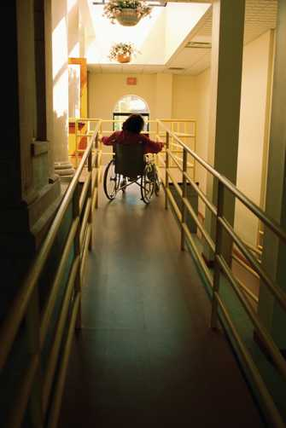
Correct answer: D
Math
This can be solved by using special triangle rules. This is a 30 – 60 – 90 triangle, so the short side is one half of the hypotenuse.
Since the hypotenuse is 20 feet, then the short side must be 10 feet.
Services for Older Adults

Slide 41
Science
Most of the calcium in your body is stored ____.
  in the blood
  in the liver
  in the small intestine
  in the bones
Nutrition and Food Science: (1)(B)

Slide 42
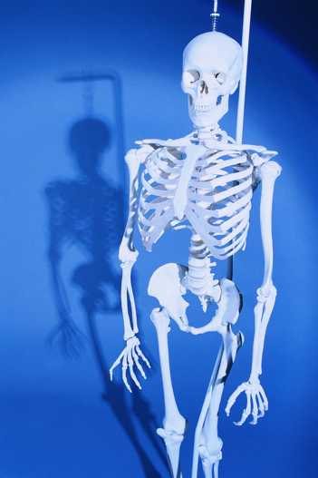
Question 30
Correct answer: D
Calcium from the diet is absorbed from the small intestine and carried to the bloodstream. The blood then carries it to the bones, where it is stored.

Slide 43

Child Development
Social Studies
Psychologist, Jean Piaget, theorized that children’s thinking is developed by ____.
  sequence of stages
  reinforcement
  reward and punishment
  conditioning

Slide 44
Correct Answer: A
Child Development
Social Studies
Piaget’s theory is that children learn in a sequence of stages. The other answers apply to other psychologist’s theories.

Slide 45
M/C Checklist Gronlund, Chapter 6
Design each item to measure an important learning outcome.
Present a single, clearly formulated problem in the stem of the item.
State the stem of the item in simple, clear language.
Put as much of the wording as possible in the stem of the item.
State the stem of the item in positive form, wherever possible.
Emphasize negative wording whenever it is used in the stem of an item.
Make certain that the intended answer is correct or clearly best.
Make all alternatives grammatically consistent with the stem of the item and parallel in form.

Slide 46
M/C Cont.
Avoid verbal clues that might enable students to select the correct answer or to eliminate an incorrect alternative.
Make the distractors plausible and attractive to the uninformed.
Vary the relative length of the correct answer to eliminate length as a clue.
Avoid using the alternative “all of the above,” and use “ none of the above” with extreme caution.
Vary the position of the correct answer in a random manner.
Control the difficulty of the item either by varying the problem in the stem or by changing the alternatives.
Make certain each item is independent of the other items in the test.

Slide 47
And finally……
Use an efficient item format.
Follow the normal rules of grammar.
Break (or bend) any of these rules if it will improve the effectiveness of the item.

Slide 49

True/False
Yes/No

Slide 50
True/False
Pro
  Test more content
  Faster to write, take, and grade
Con
  Guessing is a problem
  If a student knows half of the content and guesses at the other half, the score, on average, would be 75.
Notes:
Pro
In a given time period, a true-false test can sample many more bits of information about a topic than any other type of test format.

Slide 51
Things to Avoid in T/F
Taking direct quotes from the chapter and adding “not” to it to make it false.
  Parenting does not refer to the role of parents.
  Pregnant women need not worry about eating the right foods to nourish their bodies and their unborn children.
Avoid “all” or “always.” These are usually false.
  Medicaid is a government program that provides medical care for all individuals who are unable to pay for it.

Slide 52
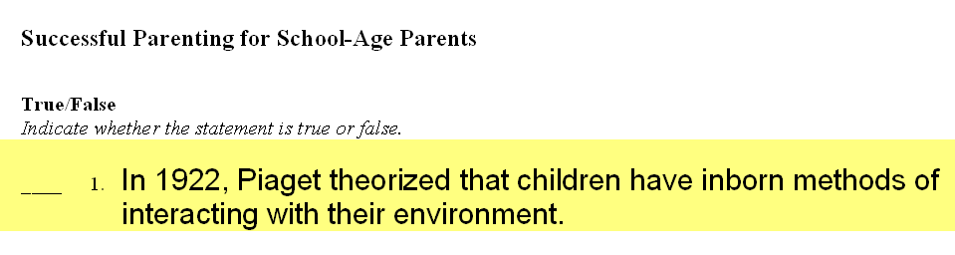
One central idea per question
This question tests 3 things
    Date
    Person
    Theory
Limit the number of items tested for in each question.

Slide 53
Other hints for T/F question writing
Keep the statement short and use simple vocabulary and sentence structure.
Word the statement so precisely that it can unequivocally be judged T or F.
Use negative statements sparingly and avoid double negatives.

Slide 54
T/F continued…..
Statements of opinion should be attributed to some source unless used to distinguish facts from opinion.
When cause-effect relationships are being measured, use only true propositions.
Avoid extraneous clues to the answer.
Base items on introductory material to measure more complex learning outcomes.
Pages 112-117 Gronlund

Slide 55
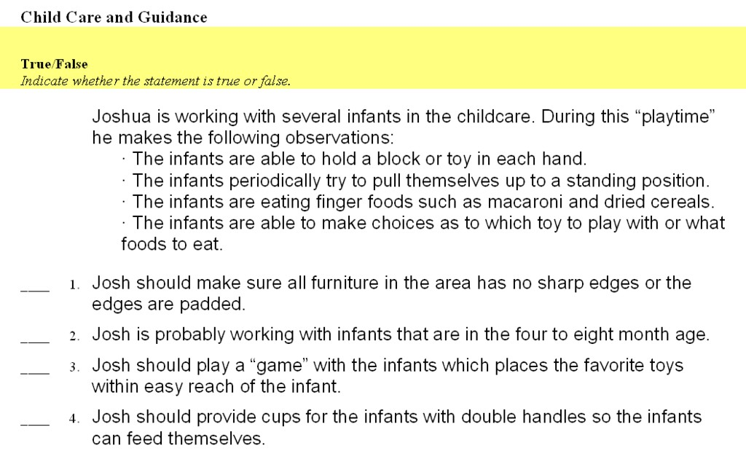
Upper Level Multiple T/F
Notes:
This one starts with a narrative, stem, or scenario followed by a number of statements, each one being either true or false.

Slide 56
Upper Level T/F
Breakfast
Hot oatmeal
Buttered biscuit with jam
Cranberry Juice
Hot tea
Lunch
Turkey sandwich
Whole wheat toast
Lettuce/tomato
Peach slices
Skim milk
Dinner
Roast chicken breast
Baked sweet potatoes
Spinach salad
Chocolate cake/icing
This day’s menu provides vitamin A sources.
This day’s menu provides vitamin C sources.
This day’s menu plan is good for colon cancer prevention.

Slide 57
Judge a T/F
Students are asked to judge a statement as T/F and then to change the false statements so they are true.
To avoid students changing by putting in a negative, the words that can be changed would be underlined. (Key parts of true statements would need to be underlined as well.)

Slide 58
Example
True-false items are classified as a supply-type item.
The answer is false -- correction would be:
T/F items are classified as an alternative response item.

Slide 59
Cluster type T/F
Useful in replacing M/C that have more than one correct answer.
Example:
Which of the following terms indicate observable student performance? Circle Y for yes and N for no.
*Y N 1. Explains
*Y N 2. Identifies
Y *N 3. Learns
*Y N 4. Predicts
Y *N 5. Realizes

Slide 60
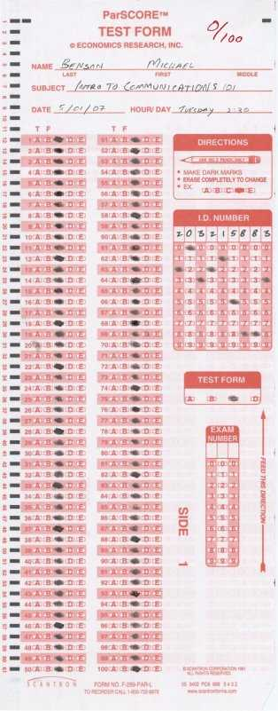
B Is the New C
Notes:
Apparently someone was listening when they heard the rumor “C is the most popular answer choice for teachers. Mark all your answer C and you’ll usually make at least a 50.” I’m not sure that every works, but I’m positive that it never works with a True/False test.

Slide 61
Matching

Slide 62
Matching
There should be more responses than there are stimuli so that the last choice requires a decision also.
Each matching group should contain only homogeneous material.
Arrange items in an order if feasible; alphabetize or put in chronological order.
Can use for all cognitive levels.

Slide 63
More hints for Matching items -
Keep the lists of items short and brief and place the brief responses on the right.
Use a larger, or smaller, number of responses than premises, and permit the responses to be used more than once.
Specify in the directions the basis for matching and clarify amount of times responses can be used.
Use capital letters.
Use illustrations when possible.
Put all of matching items on the same page.

Slide 64
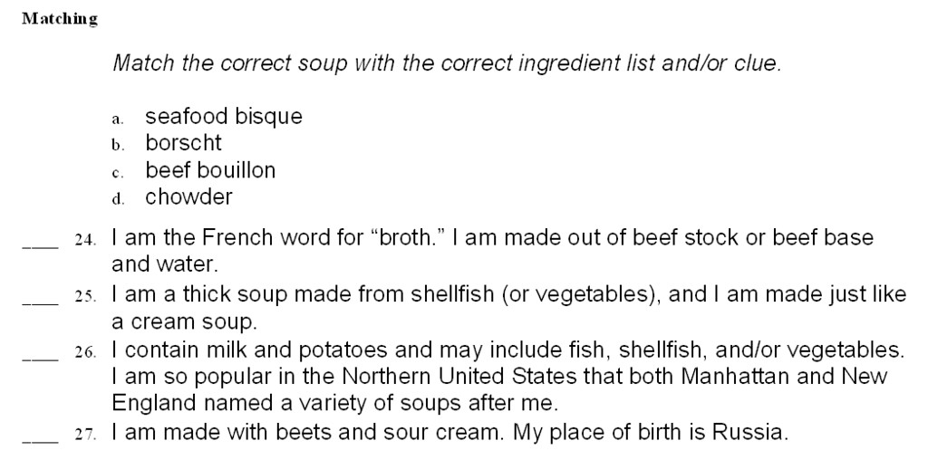
Level 2 Matching
Food Production

Slide 65
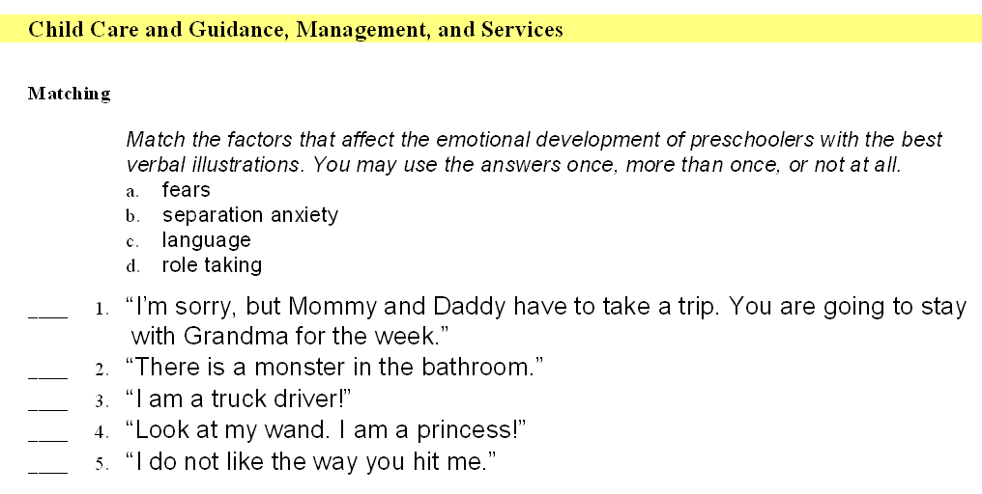
Level 2 Matching

Slide 66
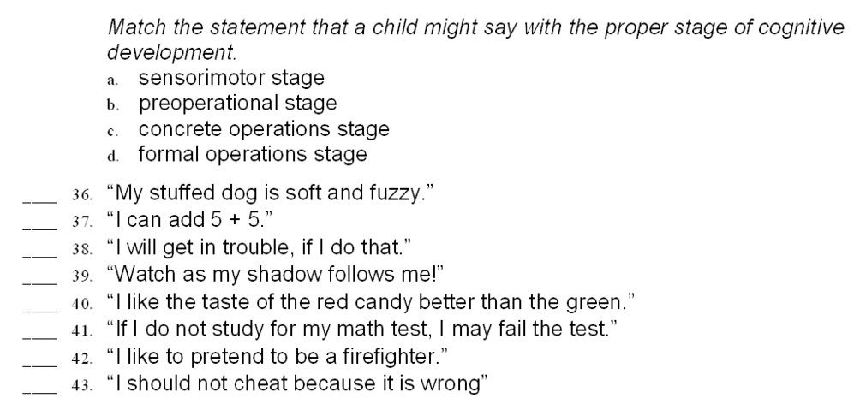
Higher Level Matching
Child Care and Guidance

Slide 67
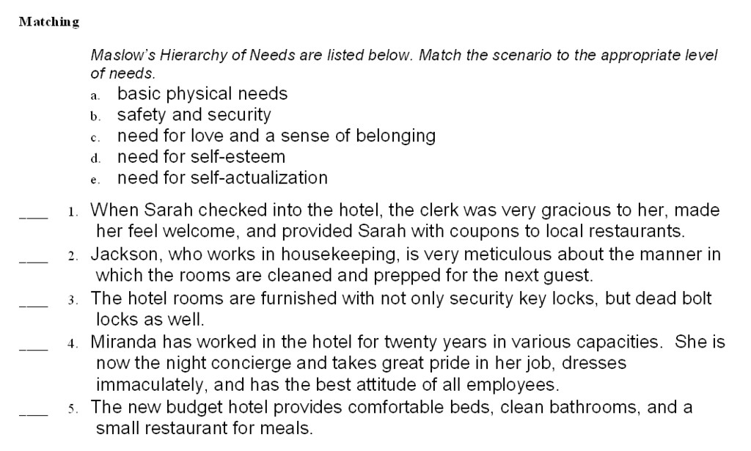
Higher Level Matching
Hospitality Services

Slide 69
Completion
Fill in the Blank

Slide 70
Completion
Does not assess higher cognitive levels well.
Wide range of correct answers is possible.

Slide 71
Completion Tips
Write completion items that can be answered with a single word.
Word statements so that they have only one correct answer.
Delete only key words from statements.
Do not copy statements directly from the textbook. This encourages students to memorize rather than understand.
Make all blanks the same length so don’t give hint.

Slide 72
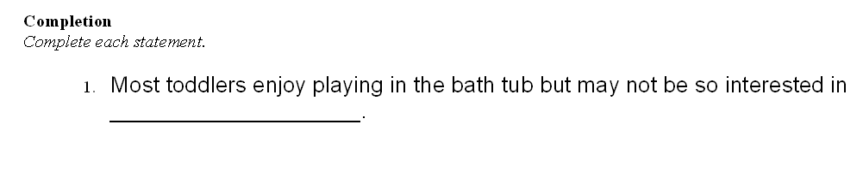
Completion
There are multiple ways to answer the questions. The student could guess and get a reasonable answer, but would it be the answer the teacher is looking for?
The correct answer is “cleanliness.”

Slide 73
Completion
✗
The study that is powerpoint is based on hated fill in the blank question.
They never saw one that wouldn’t have been better as a true/false or a multiple choice.
They were all level one.
blank

Slide 74
Short Answer and Essay

Slide 75
Short Answer and Essay
Pros
  Most useful when assessing complex learning skills.
  Relatively easy to construct.
  Emphasizes communication skills
  Requires the student to construct the response
  Guessing doesn’t work (but they will try to bluff).
Cons
  Difficult to score
  Time-consuming to score
  Provide a limited sample of the content in the lesson

Slide 76
Essay Tips
Good questions to ask
  Compare and contrast
  Present arguments
  Cause and effect
In the question, point the student toward the answer you expect.

Slide 77
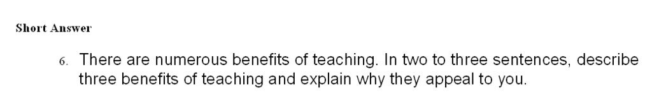
Short Answer
Reaching to Teach
Be specific as to the length of answer to make sure they weren’t too short.

Slide 78
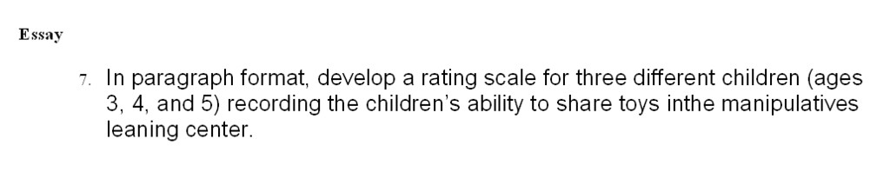
Essay
Child Development
Essay
7. In paragraph format, develop a rating scale for three different children (ages 3, 4, and 5) recording the children’s ability to share toys in the manipulatives learning center.
Be specific as to the length of answer to make sure it wasn’t too short.

Slide 79
Problem

Slide 80
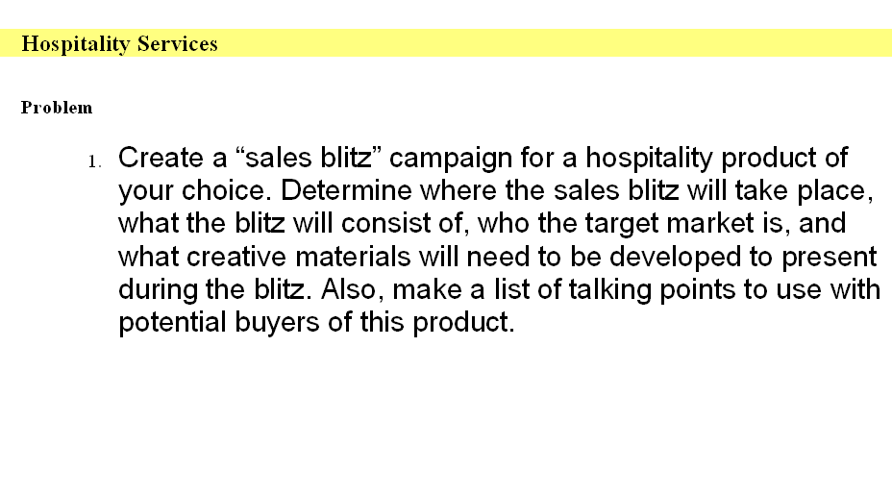
Problem

Slide 81
Rubrics Overview

Slide 82
Rubrics
A rubric is ___.
  a scoring guide used to evaluate a student’s performance based on the sum of a full range of criteria rather than a single numerical score.
  an authentic assessment tool used to measure students’ work.
  a teaching tool that supports student learning and the development of sophisticated thinking skills.

Slide 83
Features of a Rubric
Instructional rubrics have several features that support learning:
  They define and describe quality work.
  They are written in language that students can understand.
  They refer to common weaknesses in students’ work and indicate how such weaknesses can be avoided.
  They can be used by students to assess their works-in-progress and thereby guide revision and improvement.
  They enhance the quality of direct instruction.

Slide 84
Why Use Rubrics
Rubrics reduce the amount of time teachers spend evaluating student work. Teachers often find that self- and peer-assessment according to a rubric addresses many of the issues that need improving.
When they do have something to say, they can often simply circle an item in the rubric, rather than struggling to explain the flaw or strength they have noticed and figuring out what to suggest in terms of improvements.

Slide 85
Why Use Rubrics
Instructional rubrics are easy to use and to explain.
They provide students with more informative feedback about their strengths and areas in need of improvement than traditional forms of assessment do.
Teachers can increase the quality of their direct instruction by providing focus, emphasis, and attention to particular details as a model for students.
Students have explicit guidelines regarding teacher expectations.
If students go to a writing center or content mastery class, the tutor/instructor will have specific definitions on what is expected.

Slide 86
You Need a Rubric If . . .
You’re weeks behind in your grading.
You worry that you were tougher or easier on the last papers you graded.
It takes the whole class period to explain an assignment.
You’ve explained the assignment, but the students keep asking questions.
You’re getting carpal tunnel from writing the same comment over and over.
What you said and what they heard are two different things.

Slide 87
Common Elements
Most rubrics have three features in common.
  A list of criteria - what counts in the evaluations of a project or assignment
  Gradations of quality - descriptions of strong, satisfactory, and problematic work.
  The specific indicators describing what the various levels of excellence look like for each of the criteria.
    Describe what excellence looks like in a product or performance for any one criteria. Avoid words such as “excellent” or “poor”—rather.

Slide 88
Terms
Task Description
 | Scale level 1 | Scale level 2 | Scale level 3
Criteria 1 | indicator | indicator | indicator
Criteria 2 | indicator | indicator | indicator
Criteria 3 | indicator | indicator | indicator
Criteria 4 | indicator | indicator | indicator

Slide 89
Weighted Rubric
A weighted rubric clearly communicates to the students which parts of the project are more important to learn for a particular activity.
A weighted rubric focuses attention on specific aspects of a project.

Slide 90
Guidelines for Developing
Instructional rubrics have the potential to scaffold students’ learning if the rubrics and the assignment have certain characteristics.
  Articulate clear, assignment-specific criteria for the assignment.
  Provide guidance in meeting the criteria.
  Provide opportunities for improvement through revision.
  Be sensitive to students’ developmental readiness by referring to appropriate grade level standards.

Slide 91
Establishing Criteria
Judges of math problem solving tend to focus too much on obvious computational errors.
Judges of writing tend to focus too much on mechanics and not enough on the power of the writing.
We do not want to score the strengths and weaknesses that are easy to see and count.
We want to use criteria that relate most directly to the purpose and nature of the task.

Slide 92
Establishing Criteria
The challenge is to make sure that we have a feasible set of the right criteria, and that we have distinguished between genuine criteria and mere indicators or useful behaviors.

Slide 93
Establishing Criteria
Classroom discussion
Notes:
For example--class discussion.
All teachers want to improve it, yet few formally assess it.
Many students fail to adequately grasp their role and goal in participating in it.
What is the purpose of discussion?
The aim is not merely to talk a lot and share opinions, as many students believe.
The goal is collaborative and insightful inquiry into texts and ideas.

Slide 94
For example--class discussion.
All teachers want to improve it, yet few formally assess it.
Many students fail to adequately grasp their role and goal in participating in it.
What is the purpose of discussion?
The aim is not merely to talk a lot and share opinions, as many students believe.
The goal is collaborative and insightful inquiry into texts and ideas.

Slide 95
Tips for Designing
Avoid unclear language, such as “creative.” If using similar, hard to define, or nebulous words, give examples so students will understand what you are looking for.
Avoid evaluative language (“excellent” “poor”) and comparative language (“better than” “worse than”).
Avoid unnecessarily negative language.

Slide 96
Tips for Designing
Articulating gradations of quality is difficult. It may help to spend time thinking about criteria and how best to chunk them. You may want to think of gradations of quality as: “Yes,” “Yes, but,” “No, but,” and “No.”
 | Yes | Yes, but | No, but | No
Completed the project

Slide 97
Using Rubrics in the Classroom
Give copies to students at the beginning of the assignment. Discuss the expectations.
Have students assess their own progress by referring to the rubric. Allow students to revise their work.
Rubrics may be used for peer-assessment.
Share the rubrics with parents.
Use rubrics for grading.

Slide 98
Changing Roles of Teachers and Students
Instead of reading papers and assignments, the teacher will spend time up front, defining and clarifying expectations and levels of excellence.
The burden shifts from the teacher to the student to self-assess his or her own performance and make adjustments.
Rubrics may help change the role of student from observer to self-assessor and self-teacher.
Teacher Student

Slide 99
Final Rubrics Product

Slide 100
Rubric for Classroom Discussion
Task Description: (Teacher may explain specific assignment in this space.)
Criteria | weight | Exemplary | Effective | Minimal | Unsatisfactory
Level of Engagement | 50% | Contributes to class activities by offering quality ideas and asking appropriate questions on a regular basis Actively engages others in class discussions by inviting their comments Constructively challenges the accuracy and relevance of statements made Effectively identifies and summarizes main points | Contributes to class activities by offering ideas and asking questions on a regular basis Often engages others in class discussions by inviting their comments Challenges the accuracy and relevance of statements made Identifies and summarizes main points | Occasionally contributes to class activities by offering ideas and asking questions Sometimes engages others in class discussions Sometimes has an understanding of main points Identifies and summarizes some of the main points | Fails to contribute to class activities Fails to invite comment/opinions from other students Demonstrates little understanding of main points Does not identify or summarize main points
Preparedness | 25% | Always prepared for class with assignments and required materials Accurately expresses foundational knowledge pertaining to issues raised during the discussion | Usually prepared with assignments and required materials Expresses basic foundational knowledge pertaining to class discussions | Seldom prepared with assignments and required materials Expresses limited foundational knowledge pertaining to class discussions | Consistently unprepared for class Expresses no relevant foundational knowledge
Attitude | 25% | Consistently positive, cooperative attitude during class Always supportive of other students’ ideas | Usually positive and cooperative with classroom projects and discussions Often supportive of other students’ ideas | Seldom actively participates in classroom projects and discussions Sometimes supportive of other students’ ideas | Rarely if ever participates in classroom projects and discussions Occasional disruptive behavior
Assignment Score ____________ + Beyonder/Bonus ___________ = Final Score _____________

Slide 101
Rubric for Visual Display
Task Description: (Teacher may explain specific assignment in this space.)
Criteria | weight | Exceptional | Admirable | Marginal | Unacceptable
Content | 50% | Appropriate details support main idea Accurate and detailed information Information adequately supports purpose of visual | Most details support main idea Accurate information for almost all subject matter Information is mostly adequate and supportive of visual’s purpose | Few details support main idea Lacking accurate information Inadequate information is not clearly supportive of visual’s purpose | No details to support main idea Information is not accurate Information does not support the visual’s purpose
Focus | 20% | Topic and title clear and easily identified Main idea is clearly appropriate to topic All illustrations complement purpose of visual | Topic and title are mostly clear and easily identified Main idea is appropriate to topic Most illustrations complement purpose of visual | Topic and title difficult to identify Main idea not clearly stated Few illustrations complement purpose of visual | Topic and title are not clearly identified No main idea Illustrations do not complement purpose of visual
Visual Appeal | 20% | Outstanding use of color, design, and space Original and creative design Overall design is pleasing and harmonious | Adequate use of color, design, and space Design is adequate Overall design is mostly pleasing and harmonious | Inappropriate use of color, design, and space Design lacks creativity Lack of harmonious design in presentation | Little attempt to use color, design and space appropriately Design is dull Project has sloppy appearance
Mechanics | 10% | Free of grammatical errors No excess glue, torn edges, mark-outs Words are legible and pertinent to topic | Mostly free of grammatical errors Little use of excess glue, torn edges, mark-outs Most words are legible and pertinent to topic | Frequent grammatical errors Excess glue, torn edges, and mark-outs Presentation is illegible and confusing | Too frequent grammatical errors Distractive elements make illustration ineffective
Assignment Score _____________ + Beyonder/Bonus ____________ = Final Score ______________

Slide 102
Rubric for Oral Presentation
Task Description: (Teacher may explain specific assignment in this space.)
Criteria | weight | Exemplary 4 | Accomplished 3 | Developing 2 | Beginning 1
Content | 50% | Accurate Appropriate Detailed Organized Full understanding of topic | Mostly accurate Mostly appropriate Mostly detailed Mostly organized Good understanding of topic | Partially accurate Partially appropriate Partially detailed Partially organized Fair understanding of topic | Inaccurate Inappropriate Not detailed Unorganized Does not understand topic
Verbal Skills | 20% | Speaks clearly Projects voice Pronounces all words correctly No vocalized pauses (uh, um. well) | Speaks clearly most of the time Projects voice most of the time Pronounces words correctly most of the time 1-5 vocalized pauses | Speaks somewhat clearly Projects voice somewhat Pronounces some words incorrectly 6-9 vocalized pauses | Speaks unclearly Weak voice projection Incorrect pronunciation 10 or more vocalized pauses (uh, um, well)
Non-Verbal Skills | 20% | Utilized eye contact well Appropriate facial expressions (smiles, appears interested) Appropriate hand gestures Exhibits good posture; stands up straight with both feet on the ground | Some eye contact Some appropriate facial expressions Some appropriate hand gestures Exhibits good posture most of the time | Rarely uses eye contact Very few facial expressions Very few appropriate hand gestures Poor posture most of the time | Does not look at audience Expressionless No hand gestures shown Sits, slumps, sways
Mechanics/ Visual Aids | 10% | Correct grammar; usage Correct spelling Graphics and pictures are attractive and support theme | Correct grammar most of the time 1-2 spelling errors A few graphics are unattractive | Sometimes uses poor grammar 3-5 spelling errors Graphics and pictures are unattractive | Uses poor grammar 6 or more spelling errors Graphics and pictures detract from presentation
Assignment Score ___________ + Beyonder/Bonus _________ = Final Score _____________

Slide 103
Sources
About Alternative Assessment. Available: http://www.aurback.com/alt_assess.html
The Advantages of Rubrics http://www.teachervision.fen.com/page/4522.html
Goodrich Andrade, H. (2001). The effects of instructional rubrics on learning to write. Current Issues in Education [On-line], 4 (4). Available: http://cie.ed.asu.edu/volume4/number4/
Goodrich Andrade, H. (1997). Understanding Rubrics. Educational Leadership, 54 (4). Available: http://www.middleweb.com/rubricsHG.html
Goodrich Andrade, H. (2000). Using Rubrics to Promote Thinking and Learning. Educational Leadership, 57 (4). Available: http://www.education.tas.gov.au/ocll/currcons/profreadings/andrade.htm
Jacobs, H. Introduction: Redefining Assessment. Available: http://www.phschool.com/professional_development/assessment/alternative_assessment.html
Stevens, D. (2005). Introduction to Rubrics. Sterling, VA: Stylus Publications.
Why Rubrics? http://www.teach-nology.com/tutorials/teaching/rubrics/print.htm
Wiggins, G. (1998). Educative Assessment: Designing Assessments to Inform and Improve Student Performance. San Francisco, CA: Jossey-Bass, Inc.
Wiggins, G. Grant Wiggins on Assessment The George Lucas Educational Foundation, 2007
Schreyer Institute for Teaching Excellence, Teaching and Learning with Technology, Penn State University (2003) http://tlt.its.psu.edu
Nora V. Odendahl, “Assessments :: Put Your Tests to the Test,” T.H.E.Journal, 1/1/2007, http://www.thejournal.com/articles/1998
Reeder, E. (2/11/2002). Measuring What Counts: Memorization Versus Understanding
Jacobs, L.C., & Chase, C.I. (1992). Developing and Using Tests Effectively: A Guide for Faculty. San Francisco, CA: Jossey-Bass.

