Slide 1
Cooperative Learning

Slide 3
Activity one will answer -

Slide 11
Key points to remember:

Slide 12
What did you think and feel in each situation? (as a student?)
Competitive (who can do the best?)
Individualistic (do your best on your own?)
Cooperative structure (team effort?)

Slide 13
Elements of TRUE Coop. Learning:

Slide 14
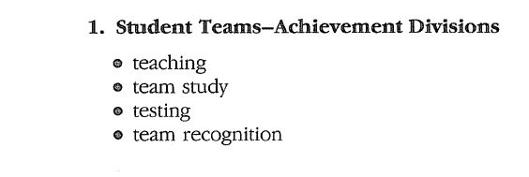
Specific structures:

Slide 16
Scores
Enter individual scores
Average, and enter on sheet

Slide 19
Team is focal point
For success as a team, each must do his/her best
STAD has 4 steps – teaching, team study, testing, and team recognition

Slide 20
Brainstorm
How could you use this structure in your lessons?

